Slide 1
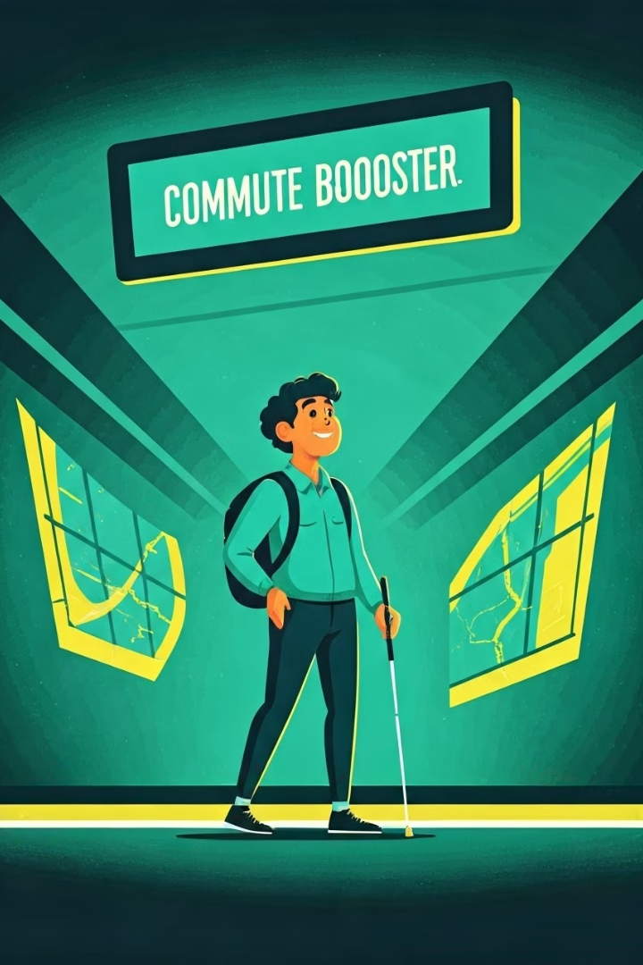
Commute Booster: A Mobile Application
for Navigation Support for People With
Blindness and Low Vision
By- Harikrishnan H.
(PRN21CS053)
Guided by:
Smt. Suzanna Charly
Assistant Professor
Dept. of Computer Science

Slide 2

Contents
1
INTRODUCTION
7
FEEDBACK MECHANISM
LITERATURE SURVEY
8
EXPERIMENTAL SETUP
2
9
RESULTS AND ACCURACY
3
PROPOSED METHODOLOGY
10
CHALLENGES AND LIMITATIONS
4
SYSTEM ARCHITECTURE
11
FUTURE WORK AND IMPROVEMENTS
5
SIGN DETECTION PROCESS
12
CONCLUSION
6
PATH PLANNING ALGORITHM
REFERENCES
13

Slide 3

Introduction
Problem Overview
Challenges faced by people with blindness and low vision (pBLV) in navigating public transportation, especially within transit hubs (middle mile).
Existing Gaps
Lack of scalable solutions for middle mile navigation, despite many outdoor navigation apps (e.g., Google Maps).

Slide 4

Introduction (cont.)
Objective
Introducing Commute Booster, a mobile app designed to provide full-trip support from first to last mile, with real-time in-station navigation.
Innovative Approach
Combines General Transit Feed Specification (GTFS) and Optical Character Recognition (OCR) to assist pBLV users during their commutes.

Slide 5

Literature Survey
1
Accessible Transportation Technologies Research Initiative (ATTRI) Impact Assessment (E.W. Martin et al., 2020)
This paper evaluates the impact of assistive technologies for accessible transportation, highlighting barriers faced by people with disabilities in transit systems and the potential of mobile apps to address these issues.
2
Seeing AI: A Mobile App for People with Blindness and Low Vision (Microsoft, 2022)
Seeing AI uses a smartphone's camera to describe people, objects, and text for pBLV users. While effective in various contexts, it struggles with text-heavy environments, like subway stations, limiting its use for real-time navigation.

Slide 6
Literature Survey (cont.)
3
NaviLens: QR Code-Based Navigation for People with Low Vision (NaviLens, 2022)
This paper evaluates the impact of assistive technologies for accessible transportation, highlighting barriers faced by people with disabilities in transit systems and the potential of mobile apps to address these issues.
4
ViNav: A Vision-Based Indoor Navigation System (J. Dong et al., 2019)
Seeing AI uses a smartphone's camera to describe people, objects, and text for pBLV users. While effective in various contexts, it struggles with text-heavy environments, like subway stations, limiting its use for real-time navigation.

Slide 7
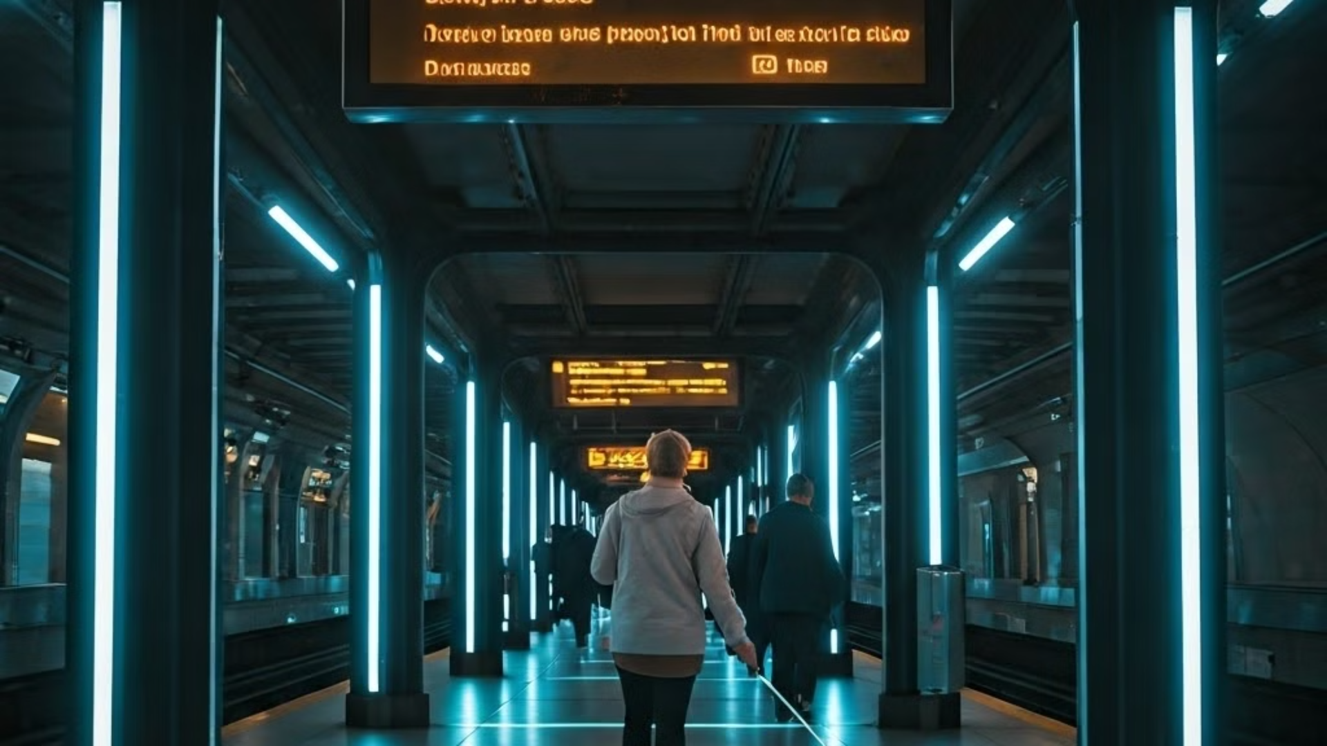



Proposed Methodology
GTFS Data Processing
User Input and Google Maps API
OCR for Sign Detection
Navigating complex transit hubs requires GTFS data.
User input along with Google maps allows setting destination and real-time location.
Provides a way to recognize characters in signs.

Slide 8



Proposed Methodology (cont.)
String Similarity Matching
Dijkstra's Path Planning
Haptic and Verbal Feedback
Compare characters from signs to the database of existing signs.
Finds the optimal path based on the map data.
Provides real-time guidance inside stations.

Slide 9
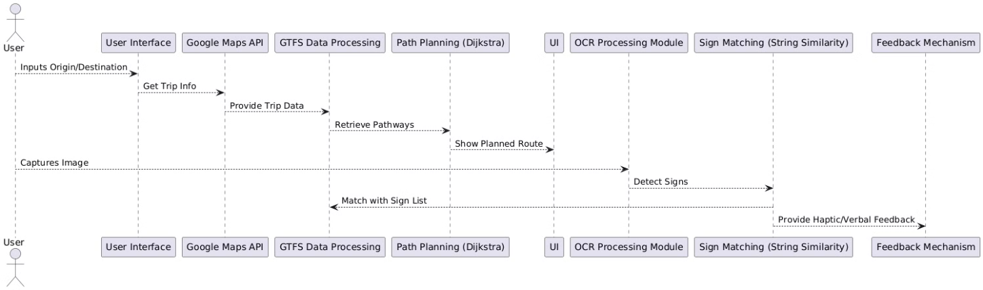
System Architecture

Slide 10
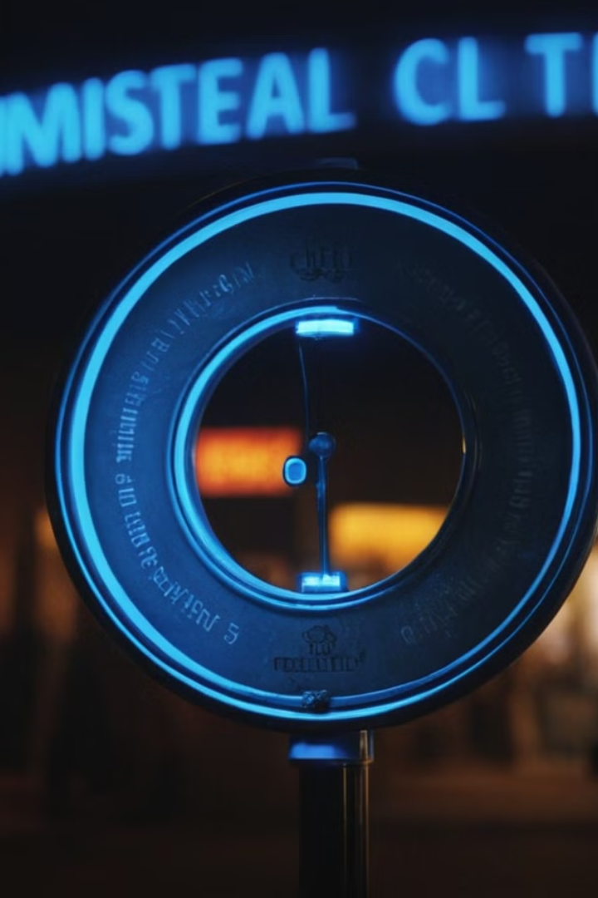
Sign Detection Process
1
Image Capture
The phone’s camera captures real-time images of the surrounding environment as the user moves through the transit station.
2
OCR Processing
Optical Character Recognition (OCR) extracts text from the captured images, recognizing relevant navigation signs in real-time.
3
GTFS Sign Matching
The detected text is compared against a list of expected signs from the GTFS dataset using string similarity algorithms.

Slide 11
Sign Detection Process (cont.)
4
Sign Relevance Check
If a match is found, the app verifies if the detected sign is relevant to the user’s journey, based on the planned route.
5
User Feedback
Upon finding a relevant sign, the app provides haptic (vibration) and/or verbal feedback to guide the user.

Slide 12

Path Planning Algorithm
1
User Input
The user specifies their origin and destination within the transit station using the app.
2
GTFS Data Retrieval
The app retrieves the relevant GTFS data for the selected origin and destination, including station layouts and pathways.
3
Graph Representation
The subway station layout is converted into a graph structure, where nodes represent key locations (entrances, platforms) and edges represent pathways.

Slide 13

Feedback Mechanism
1
Real-Time Sign Detection Feedback
The app provides immediate feedback when relevant navigation signs are detected through haptic vibrations and verbal announcements.
2
Continuous Monitoring
The app continuously scans for signs as the user moves, offering updates to feedback as the environment changes.
3
User-Centric Alerts
Feedback is tailored to the user's journey, only alerting them about signs relevant to their specified path, enhancing the navigation experience.

Slide 14
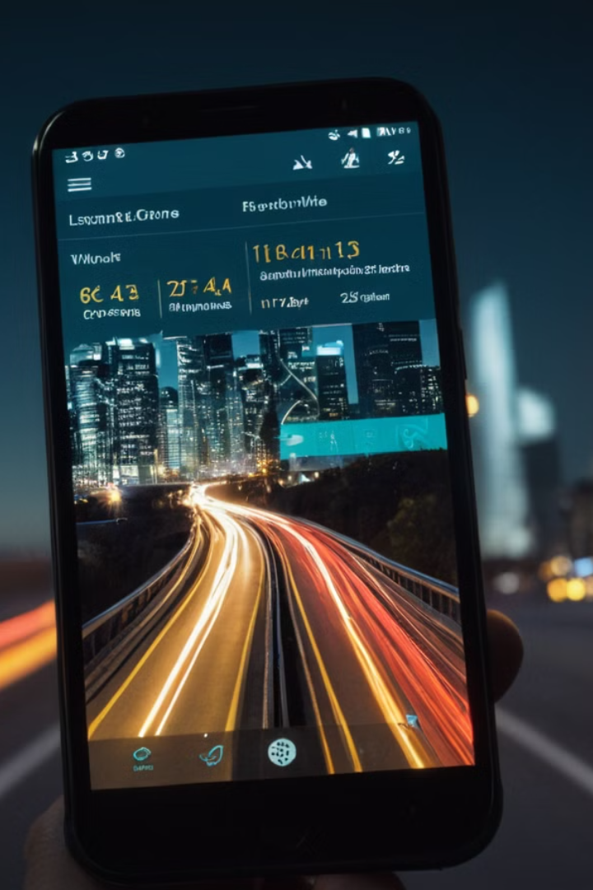



Experimental Setup
Testing Locations
Experiments were conducted in three busy subway stations in New York City: Jay St-MetroTech, Dekalb Avenue, and Canal Street.
Image Data Collection
A variety of images containing relevant signage and environmental text were captured to evaluate the app's performance in real-world scenarios.
Performance Metrics
The app's effectiveness was assessed using metrics such as accuracy, precision, and detection range for relevant signs, along with user feedback on navigation assistance.

Slide 15
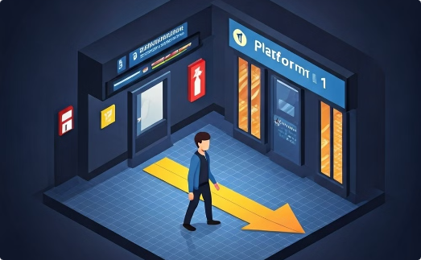
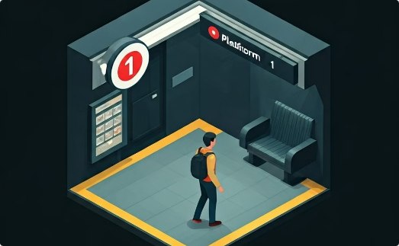
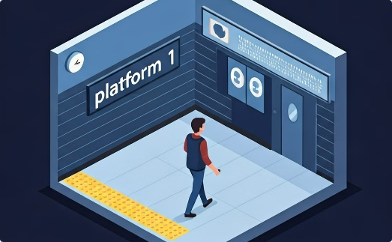
Results and Accuracy
Detection Accuracy
Precision and F1 Score
Detection Range
The Commute Booster app achieved an average detection accuracy of 97.7% during the experiments, indicating high effectiveness in recognizing relevant navigation signs.
The system recorded a precision of 64.0% and an F1 score of 71.3%, reflecting its ability to balance precision and recall in sign detection.
The app successfully detected signs from a maximum distance of 7 meters indoors, with a detection angle of up to 110 degrees, ensuring comprehensive coverage in transit stations.

Slide 16
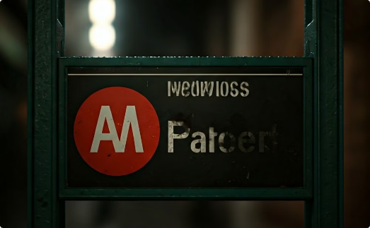
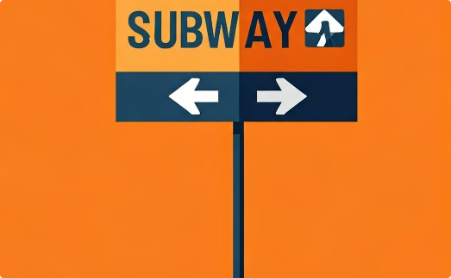
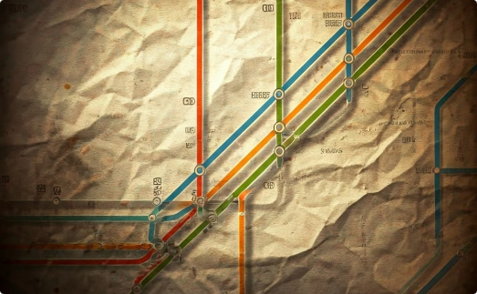
Challenges and Limitations
Inconsistent Signage
Graphical Navigation Signs
Incomplete GTFS Data
The app faced difficulties in detecting signs that were poorly illuminated or partially obstructed, which can lead to missed navigation cues.
Not all subway stations had complete GTFS-pathways data, which impacted the app's ability to provide accurate path planning in certain locations.
The system struggled with purely graphical signs that do not contain textual information, as these cannot be processed by the OCR engine.

Slide 17




Future Work and Improvements
Enhanced OCR Algorithms
Focus on improving OCR accuracy and reducing false positives in complex environments.
Expanded GTFS Coverage
Collaborate with transit agencies to increase GTFS-pathways data coverage.
User Testing and Feedback
Conduct user studies with pBLV individuals to gather real-world feedback and insights.

Slide 18
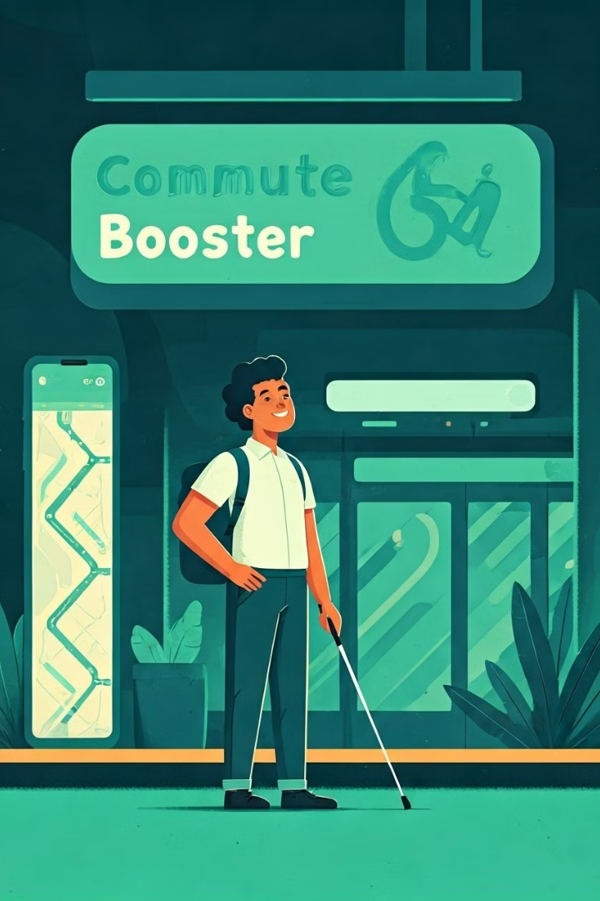



Conclusion
Innovative Solution
Commute Booster integrates GTFS and OCR technologies to assist people with blindness and low vision in navigating public transit effectively.
Proven Effectiveness
The app demonstrated high detection accuracy and reliable real-time feedback, enhancing the commuting experience for users.
Future Potential
With ongoing improvements and expanded data coverage, Commute Booster aims to become a vital tool for enhancing accessibility in urban transportation.

Slide 19
References
1
Feng, J., Beheshti, M., Philipson, M., Ramsaywack, Y., Porfiri, M., & Rizzo, J.R. (2023).
Commute Booster: A Mobile Application for First/Last Mile and Middle Mile Navigation Support for People With Blindness and Low Vision. IEEE Journal of Translational Engineering in Health and Medicine.
2
Martin, E.W., et al. (2020).
Accessible Transportation Technologies Research Initiative (ATTRI) Impact Assessment. United States Department of Transportation.
3
Microsoft Corporation. (2022).
Seeing AI App From Microsoft. Retrieved from https://www.microsoft.com/en-us/ai/seeing-ai
4
NaviLens. (2022).
QR Code-Based Navigation for People with Low Vision. Retrieved from https://www.navilens.com

Slide 20

THANK YOU

